Slide 1
Face recognition
107AB8001 蔡雯惠
107AB8003 林芝儀
107AB8014 楊婉婷

Slide 2
01 Introduction
CONTENTS
02 Code
03 Result
04 Assignment

Slide 3
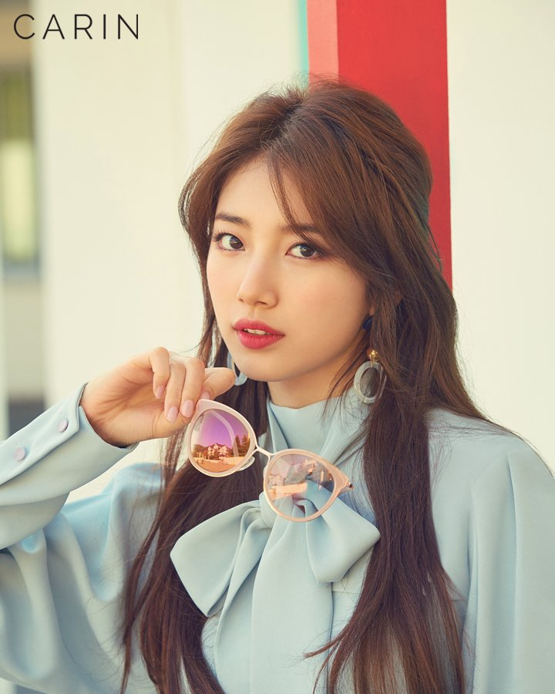
Introduction
Face recognize : Suzy
Library：face recognition、PIL
Reference：Adam Geitgey- git hub
Reference : https://github.com/ageitgey/face_recognition/blob/master/examples/identify_and_draw_boxes_on_faces.py
https://www.koreaboo.com/stories/iu-suzys-chats-brothers-expect-funny/

Slide 4
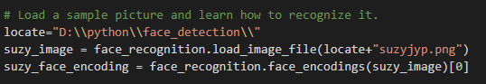
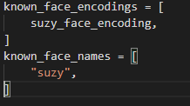
Code
Load image of Suzy, then recognize it.
Create arrays of face encodings and names
Reference : https://github.com/ageitgey/face_recognition/blob/master/examples/identify_and_draw_boxes_on_faces.py

Slide 5
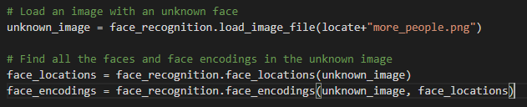

Code
Load new unknown image and find all faces and encodings.
Convert the unknown image to a PIL-format image so that we can draw on top of it with the Pillow library
Reference : https://github.com/ageitgey/face_recognition/blob/master/examples/identify_and_draw_boxes_on_faces.py

Slide 6

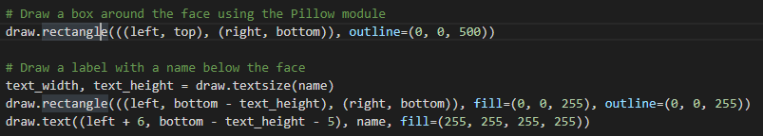
Code
Loop through each face found in unknown images and compare faces
Draw a box and name around and below the face
Reference : https://github.com/ageitgey/face_recognition/blob/master/examples/identify_and_draw_boxes_on_faces.py

Slide 7
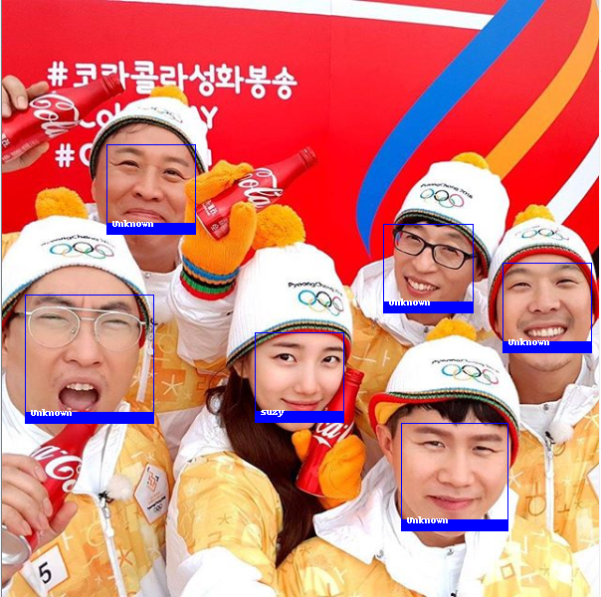
Result
Reference : https://www.instagram.com/skuukzky/

Slide 8
Assignment
Discussion & Coding: all members
Presentation: 婉婷、芝儀
PPT： 雯惠

Slide 9
THANK YOU !!

